Slide 1
CS 4310: Software Engineering
Lecture 11
Software Testing

Slide 2
Testing - objective
Execute a program to find errors
A good test case has a high probability of finding errors
A successful test finds a new error
Software specs.
Results
Test Reports
Testing
Check
Test specs.

Slide 3
Software Testing
There are two main types of Software Testing
Black Box
White Box
For the group project, you will implement Black Box testing.

Slide 4
Black Box
Black box testing . . . You know the functionality
  Given that you know what it is supposed to do, you design tests that make it do what you think that it should do
  From the outside, you are testing its functionality against the specs/requirements
  For software this is testing the interface
    What is input to the system?
    What you can do from the outside to change the system?
    What is output from the system?
  Tests the functionality of the system by observing its external behavior
  No knowledge of how it goes about meeting the goals

Slide 5
White Box
White box testing . . . You know the code
  Given knowledge of the internal workings, you thoroughly test what is happening on the inside
  Close examination of procedural level of detail
  Logical paths through code are tested
    Conditionals
    Loops
    Branches
  Status is examined in terms of expected values
  Impossible to thoroughly exercise all paths
    Exhaustive testing grows without bound
  Can be practical if a limited number of “important” paths are evaluated
  Can be practical to examine and test important data structures

Slide 6
When & What to Test?
Low
Requirements
Specifications
Acceptance
Testing
Analysis
System
Testing
Level
of Detail
Design
Integration Testing
Object Design
Unit Testing
High
Project Time
Notes:
The V-model is a variation of the waterfall model that makes explicit the dependency between development activities and verification activities. The difference between the waterfall model and the V model is that the latter makes explicit the notion of level of abstraction. Allactivities from requirements to implementation focus on building more and more detailed representation of the system, whereas all activities from implementation to operation focus on validating the system.

Slide 7
Types of Testing
Unit Testing
  Done by programmer(s)
  Generally all white box
Integration Testing
  Done by programmer as they integrate their code into code base
  Generally white box, maybe some black box
Functional/System Testing
  It is recommended that this be done by an external test group
  Mostly black box so that testing is not ‘corrupted’ by too much knowledge
Acceptance Testing
  Generally done by customer/customer representative in their environment through the GUI . . . Definitely black box

Slide 8
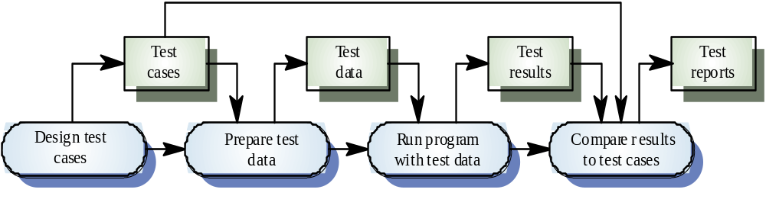
The Testing Process

Slide 9
Planning a Black Box Test Case
Look at requirements/problem statement to generate.
Said another way: test cases should be traceable to requirements.
The “Test Case Grid” Contains:
ID of test case
Describe test input conditions
Expected/Predicted results
Actual Results

Slide 10
Test Case Grid
For your analysis reports, please use the following format:
Id Input Expected Result Actual Result

Slide 11
Black Box Test Planning
The inputs must be very specific
The expected results must be very specific
You must write the test case so anyone on the team can run the exact test case and get the exact same result/sequence of events
Example: “Passing grade?”
Input field:
  Correct input: Grade = 90; Grade =20
  Incorrect input: “a passing grade” “a failing grade”

Slide 12
Example Test Case Grid
Your test case grid (last section of your analysis document) should identify at least 15 test cases.
Example: “Passing grade?”
Id Input Expected Result Actual Result
1
Grade < 70%
Fail the class with less than a C
(Leave blank until tested)
2
Grade > 70%
Pass the class with at least a C

Slide 13
Bad Test Case Example
Id Input Expected Result Actual Result
1
A failing grade
Fail the class with less than a C
(Leave blank until tested)
2
A passing grade
Pass the class with at least a C
What is a failing and passing grade?
Problem: The “input” value is too vague.

Slide 14
Failure Test Cases
What if the input type is wrong (You’re expecting an integer, they input a float. You’re expecting a character, you get an integer.)?
What if the customer takes an illogical path through your functionality?
What if mandatory fields are not entered?
What if the program is aborted abruptly or input or output devices are unplugged?

Slide 15
Using a Flow Chart
if x >= 0
Key
Decision
check=
false
if x <=100
statements
Mapping functionality in a flow chart makes the test case generation process much easier.
check=
true

Slide 16
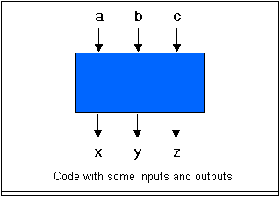
One input leads to One output
A piece of code with inputs a, b, and c. It produces the outputs x, y, and z.

Slide 17
One-to-One Testing
Each input only has one valid expected result.
To check for a valid ATM Card the following is NOT correct.
Id Input Expected Result Actual Result
1
Read ATM Card
If card is valid, accept card and ask for pin. If card is invalid, “No ATM Card” exception is thrown and card is returned to the user.

Slide 18
The correct way…
Test for ATM card
  Input: Read ATM Card
  Expected result: Accept card and ask for pin #
  Input: Read invalid card
  Expected result: “No ATM Card” exception is thrown and card is returned to the user.
Id Input Expected Result Actual Result
1
Read ATM Card
Accept card and ask for pin #
2
Read Invalid Card
“No ATM Card” exception is thrown and card is returned to the user.

Slide 19
Another test…
Test for “get PIN”
  Input: 4 digit entry of a stolen card
  Expected result: “Stolen Card” exception is thrown
Id Input Expected Result Actual Result
1
Read ATM Card
Accept card and ask for pin #
2
Read Invalid Card
“No ATM Card” exception is thrown and card is returned to the user.
Invalid PIN Entered
“Stolen Card” exception is thrown and card is destroyed.
3

Slide 20
What’s Next?
After tests are performed, the results are recorded.
Id Input Expected Result Actual Result
1
Read ATM Card
Accept card and ask for pin #
Accepted the card and asked for a pin.
2
Read Invalid Card
“No ATM Card” exception is thrown and card is returned to the user.
Accepted the card and asked for a pin.
Invalid PIN Entered
“Stolen Card” exception is thrown and card is destroyed.
Accepted the card and asked for a pin.
3

Slide 21
What’s Next?
After results are recorded, the testing report is created.
Id Input Expected Result Actual Result Status
1
Read ATM Card
Accept card and ask for pin #
Accepted the card and asked for a pin.
Passed
2
Read Invalid Card
“No ATM Card” exception is thrown and card is returned to the user.
Accepted the card and asked for a pin.
Failed
Invalid PIN Entered
“Stolen Card” exception is thrown and card is destroyed.
Accepted the card and asked for a pin.
3
Failed

Slide 22
Verification & Validation
Testing is performed during the system implementation stage and the results are delivered in the Final Report.
The Test Report provides validation and verification for the software program.
Verification: "Are we building the product right?"
    The software should conform to its specification
Validation: "Are we building the right product?"
    The software should do what the user really requires

Slide 23
Project Work
Your Analysis Document is due soon!
Next:
  Begin discussion of the Design Specification Requirements
  Review and prepare for the midterm exam
Midterm Exam, coming soon!

